Slide 1


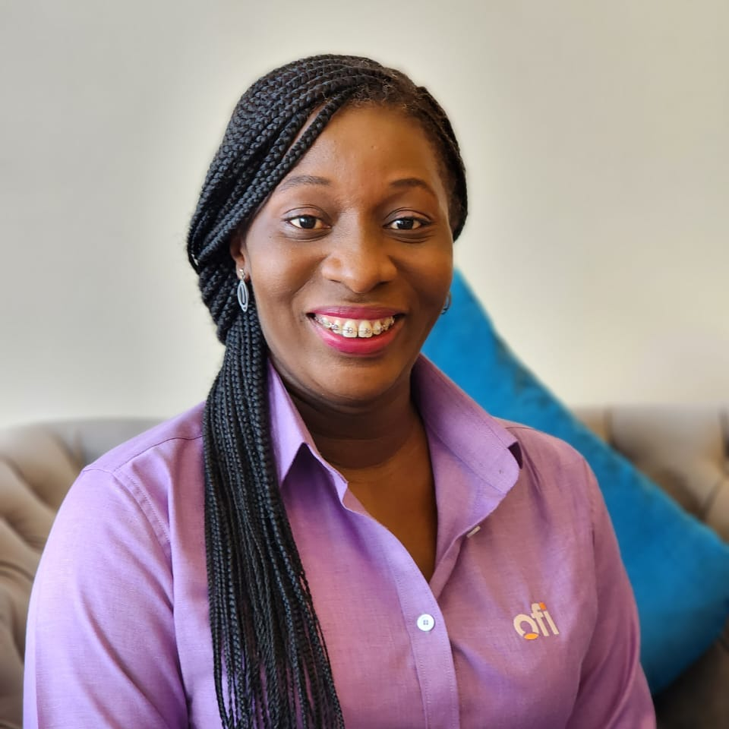
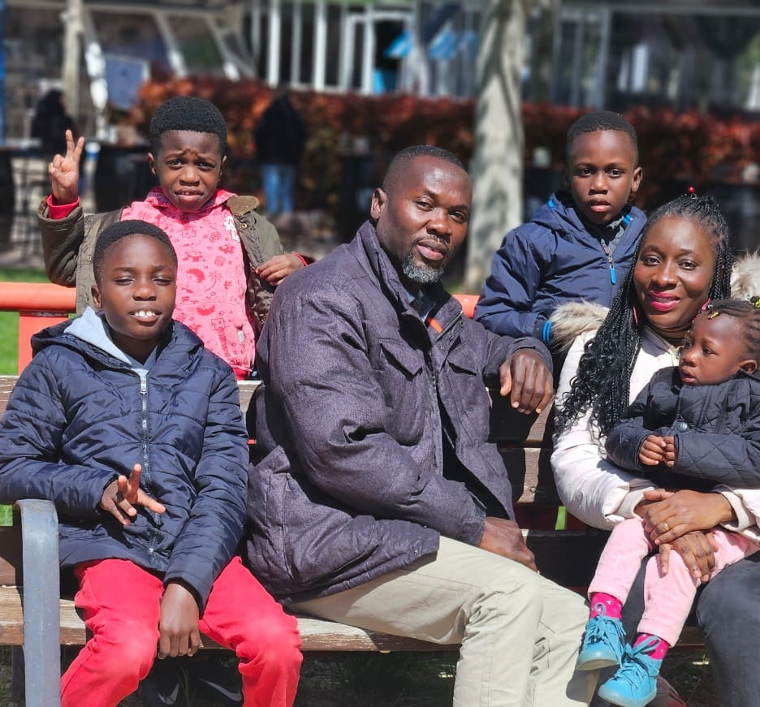
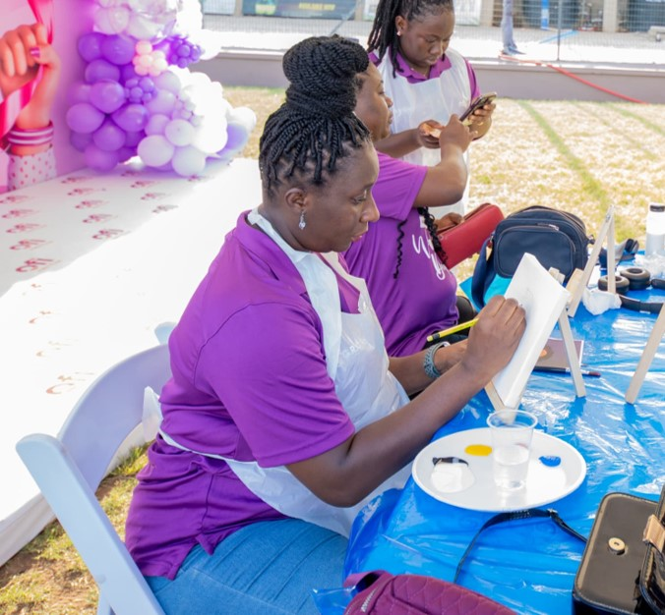
Getting to Know Me
Work
Personal
My role
HR Operations Manager
Significant others / family members / furry friends in my life
My spouse and 4 kids
Tenure in ofi/Olam
14 years
How I enjoy spending my free time
Watching movies & spending time with my kids
Previous companies I have worked at
None
My favorite / comfort food
Banku with okra stew
Why I joined ofi/Olam and what keeps me here?
1. Positive company culture
2. Opportunities for growth and development
3. Attractive reward system
My favorite song
Holy Forever by Cece Winans
Vera Armah
‘Vera’
A few fun facts about me
Ailurophobia
Ability to memorize phone contacts
This is me outside work, doing stuff I enjoy in my life …

